Slide 1
Trip planner with OpenMP
Professor: John Gash
CMPE 275 Project2
Xing Yang 010696101
Jiongfeng Chen 010830105
Dan Su 009266920

Slide 2
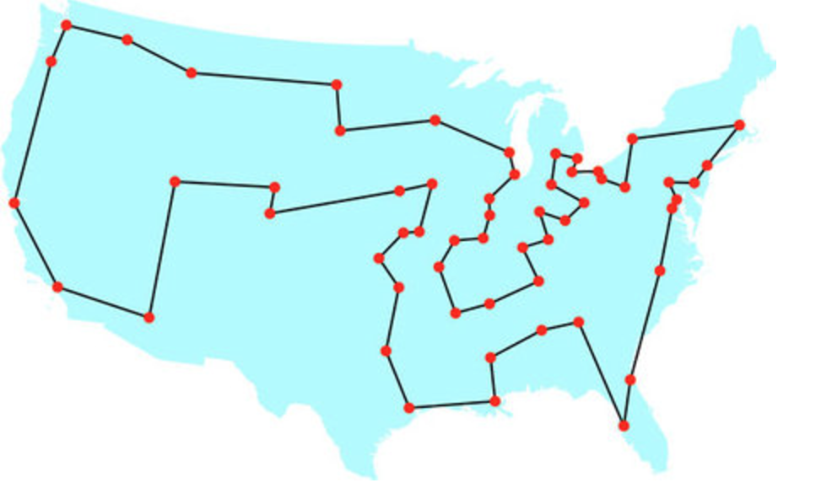
Travelling Salesman Problem
Find the best (least time or shortest way) possible route between many different locations

Slide 3
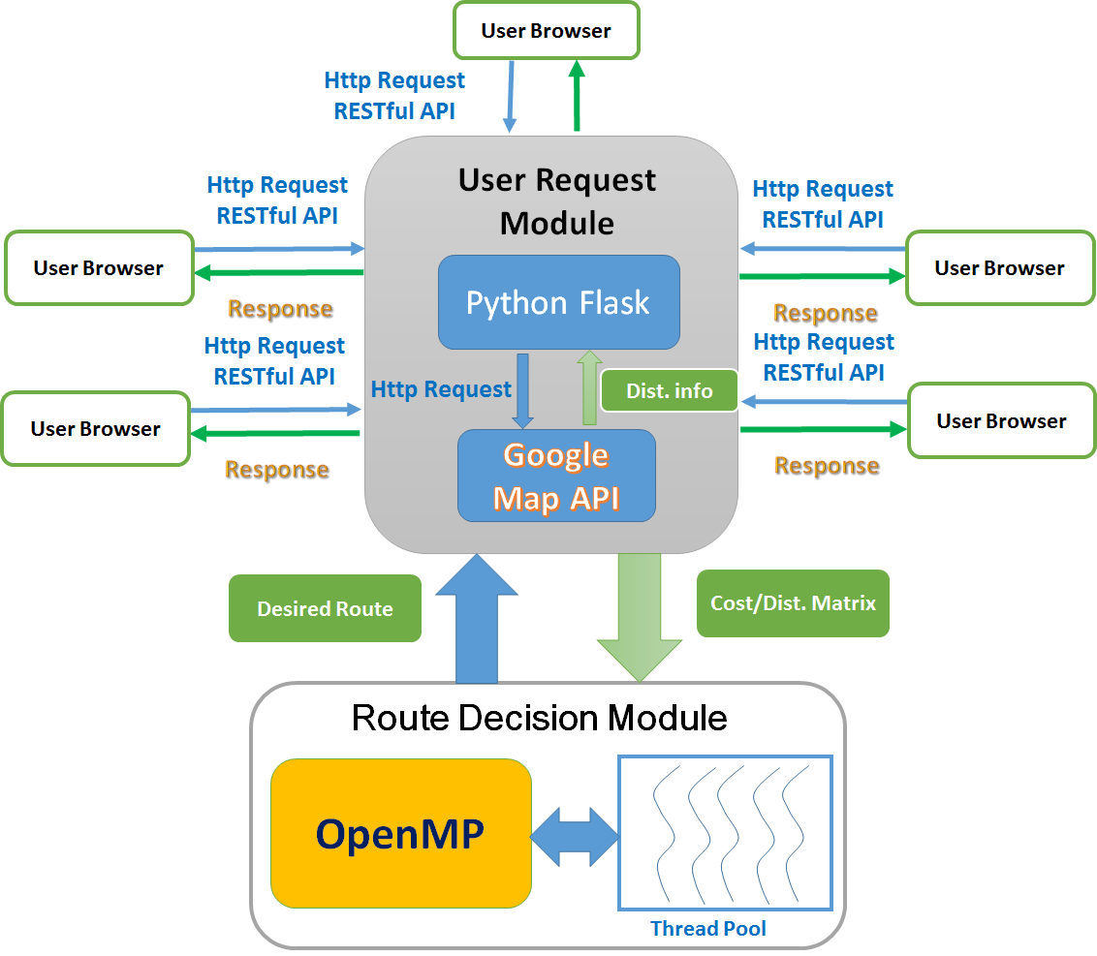
System Design & Architecture

Slide 4
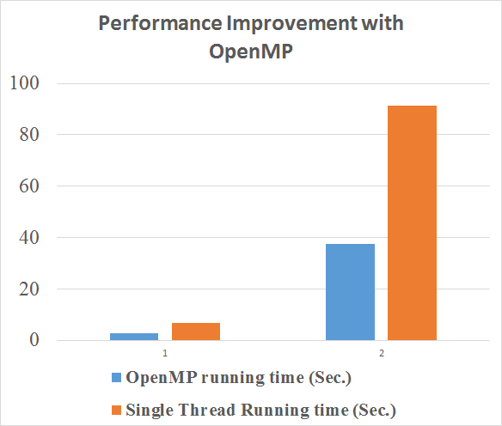
Performance
Case 1: 12 cities
Case 2: 13 cities

Slide 5
Algorithm & Parallel Computation
Use matrix represents data
Find the shortest possible route with brute force search
Use parallel computation (OpenMP) to enhance program performance

Slide 6
Python & Python Flask
Use micro framework Python Flask hosting web page
Use vue.js—a javascript framwork manipulating HTTP requests and content display
Integrate Google API with Python
Make C++ tsp parallel computation model to be an exe file. Calling this exe in Python

Slide 7
Technologies
C++, Python, OpenMP
Python Flask, Vue js, Elemental_UI
Google Map API
mySQL

Slide 8
System DEMO

Slide 9
Thank you!
Merry Christmas
Happy New Year
Cheer Winter Break
Achieve High GPA

